Slide 1
Project 1
Twitter Data Analysis Using HADOOP and HIVE

Slide 2
Description:
In this project I took twitter dataset from kaggle.com
I used ambari and I have upload files in HDFS.
I have start the hive in the sandbox.
Then I wrote the file into a table which was created in hive.
After this operation I performed query through I want analysis of twitter dataset.

Slide 3
Queries Which I Want to perform
1. Creation of table using hive
2. find out total number of users in the dataset.
3. find out the number of users above age of 25.
4. Find out average friends which gender is male.
5.Do young members use mobile phones or computer for twitter browsing?
6.Do adult members use mobile phones or computer for twitter browsing?
7.Count of twitter user for each month.
8.Copy the output of query in HDFS.
9.Create table using partition.
10.Create table using Bucket.

Slide 4
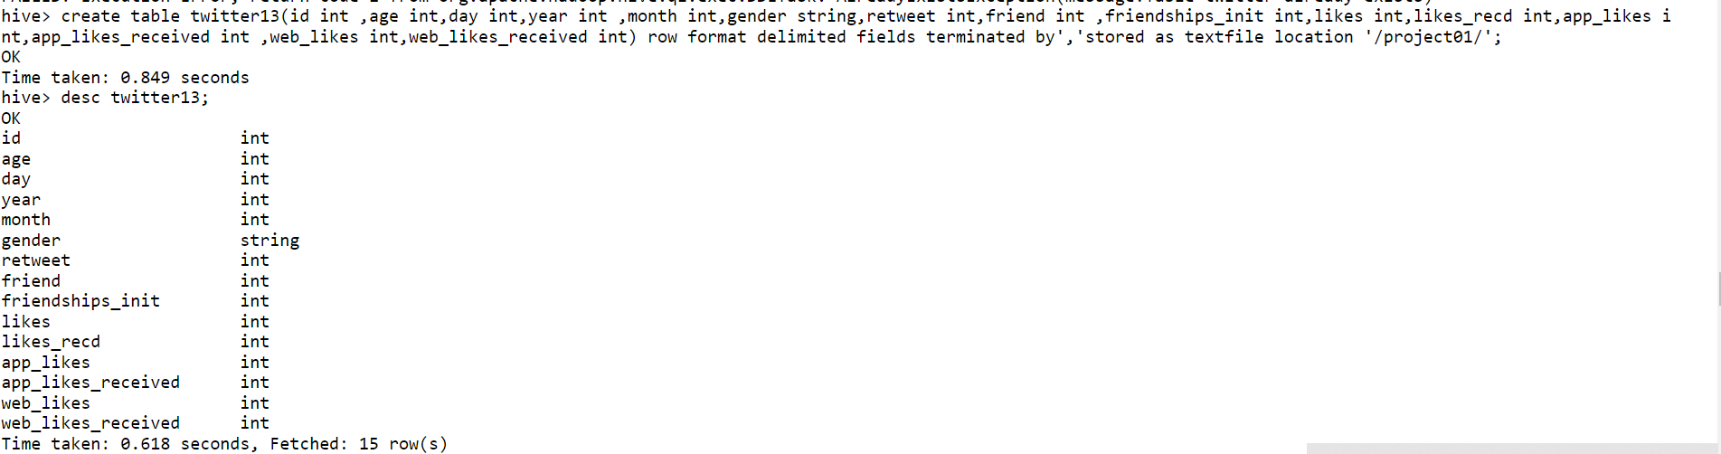
1.Creation a table using hive Syntax: create table twitter13(id int ,age int,day int,year int ,month int,gender string,retweet int,friend int ,friendships_init int,likes int,likes_recd int,app_likes i nt,app_likes_received int ,web_likes int,web_likes_received int) row format delimited fields terminated by','stored as textfile location '/project01/';

Slide 5
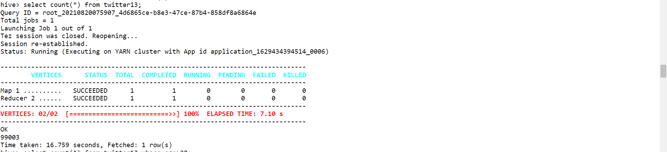
2.How many record in data set csv file Syntax: select count(*) from twitter13;

Slide 6
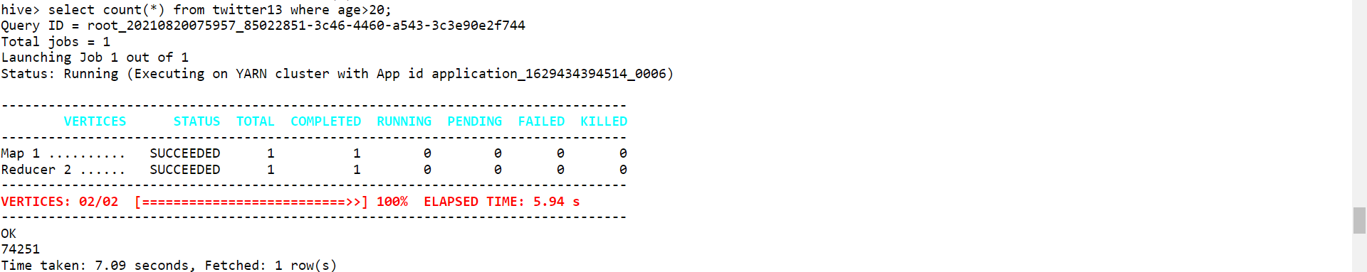
3. find out the number of users above age of 25. Syntax: select count(*) from twitter13 where age>20;

Slide 7
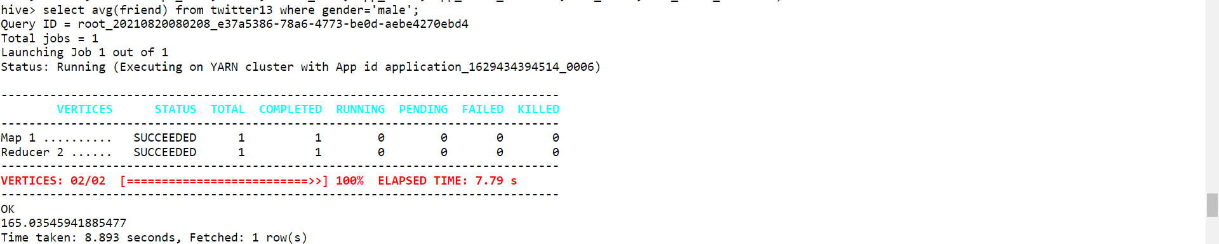
4.Find out average friends which gender is male syntax: select avg(friend) from twitter13 where gender='male‘ select avg(friend) from twitter13 where gender=‘female‘

Slide 8
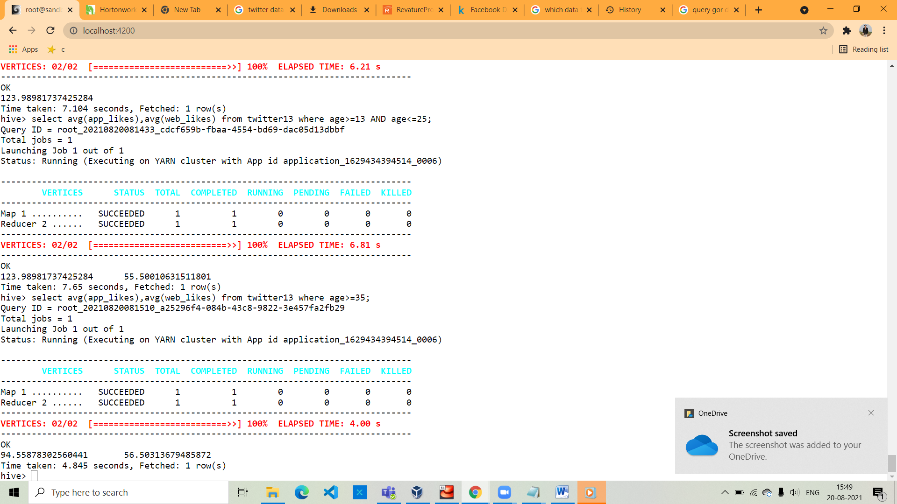
5.Do young members use mobile phones or computer for twitter browsing? Syntax: select avg(likes_recd) from twitter13 where age>=12 AND age<=25;

Slide 9
6.Do adult members use mobile phones or computer for twitter browsing? Syntax: select avg(likes_recd) from twitter13 where age>=35;

Slide 10
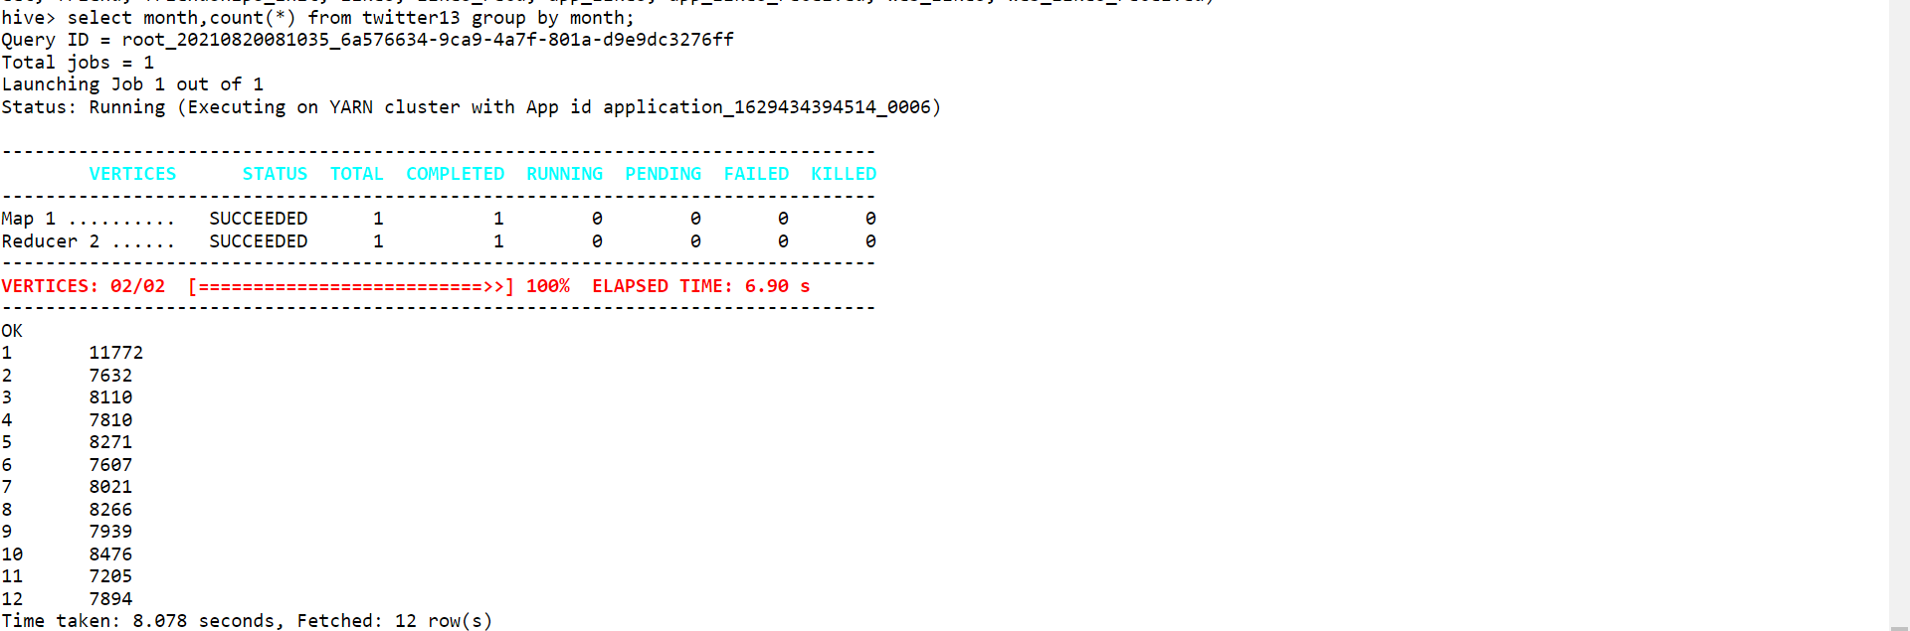
7.Count of twitter user for each month syntax: select months,count(*) from twitter13 group by months;

Slide 11
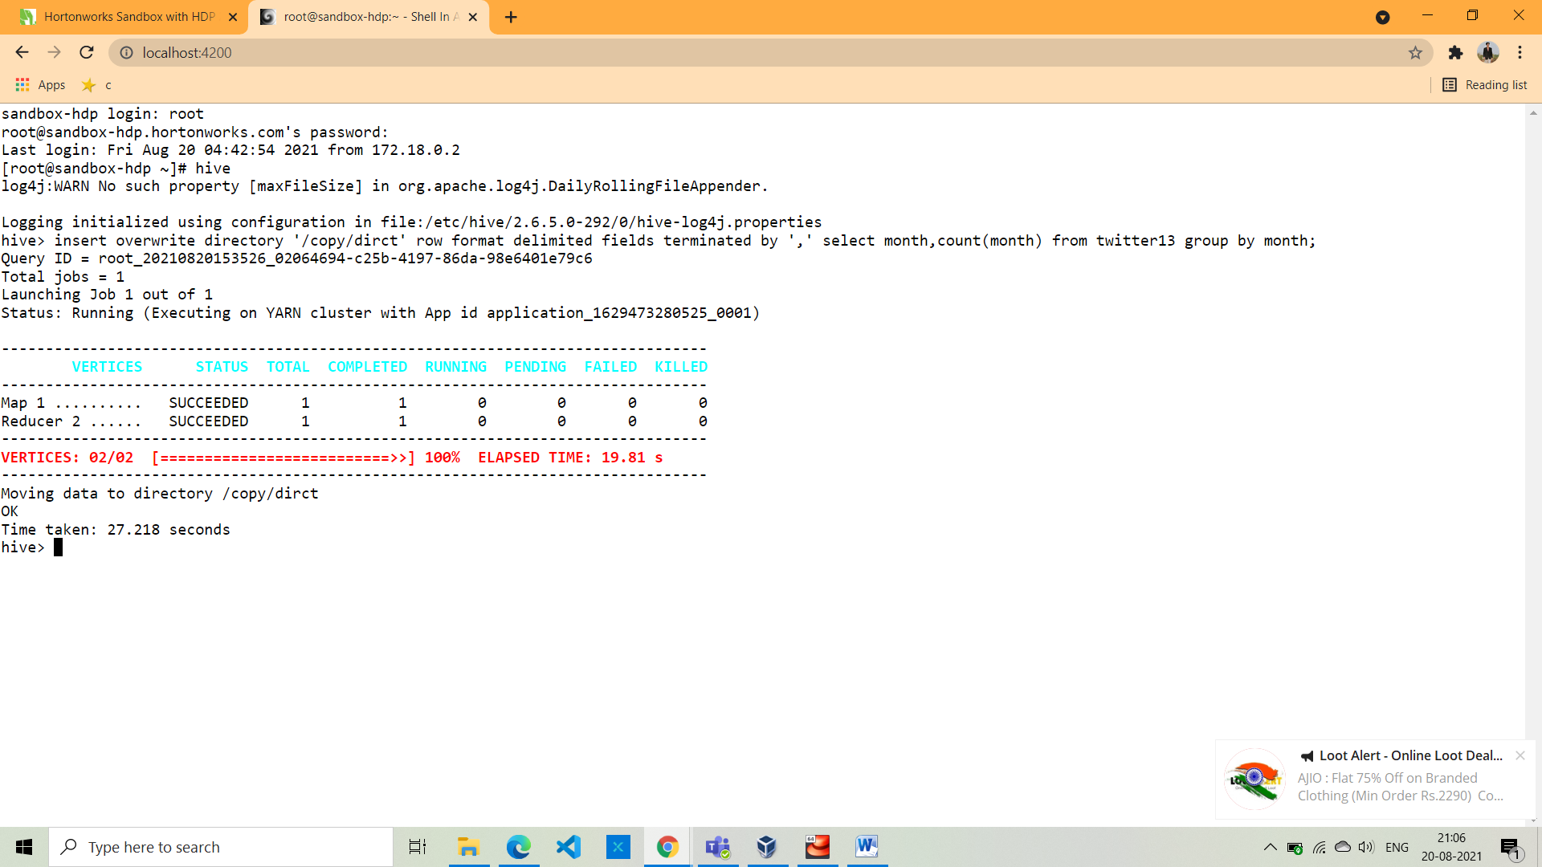
8.Copy the output of query in HDFS synatx: hive> insert overwrite directory '/copy/dirct' row format delimited fields terminated by ',' select month,count(month) from twitter13 group by month;

Slide 12
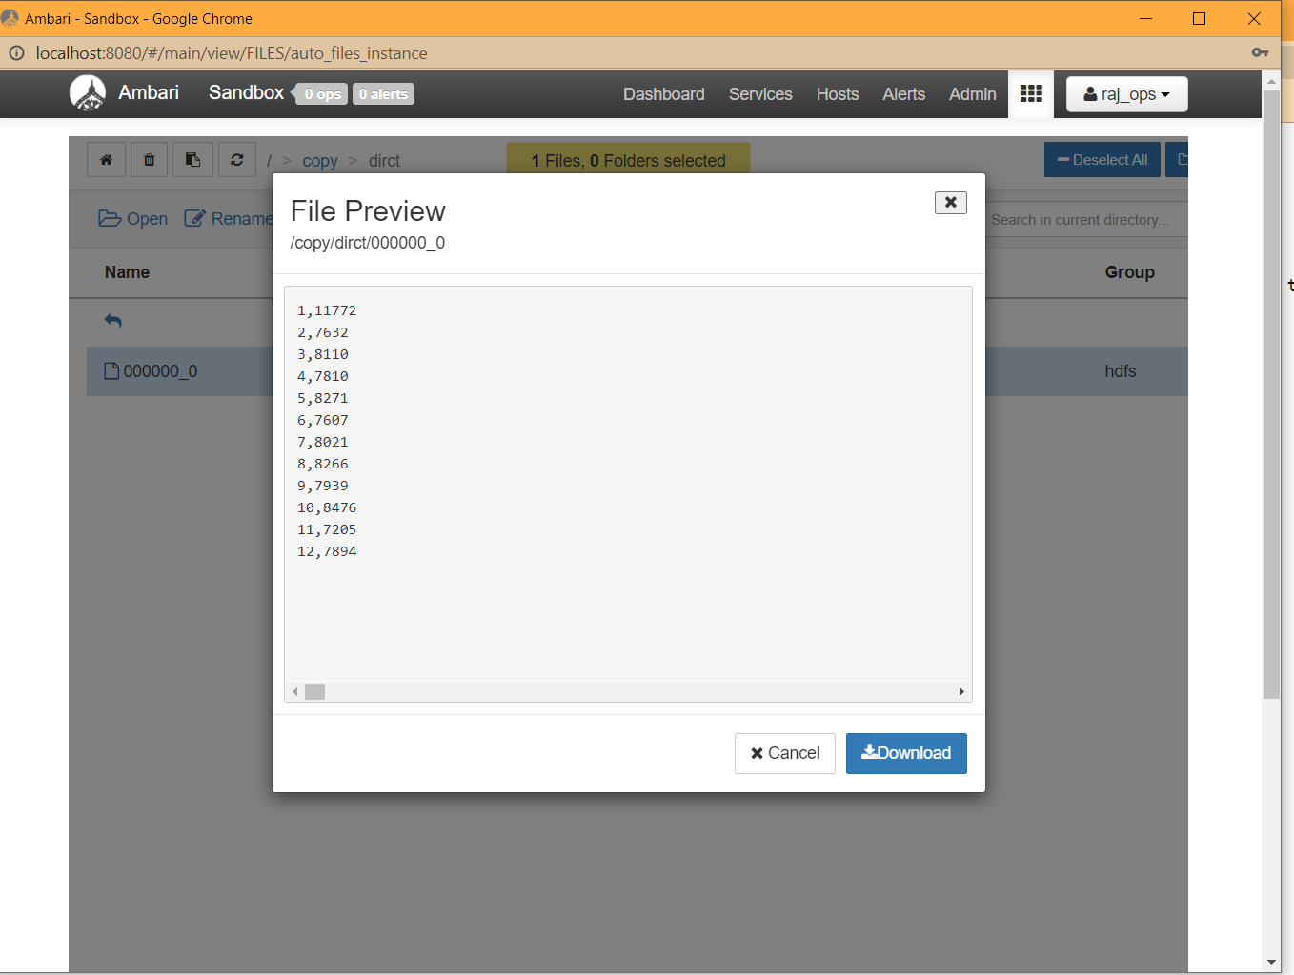
Outupt stored in file

Slide 13
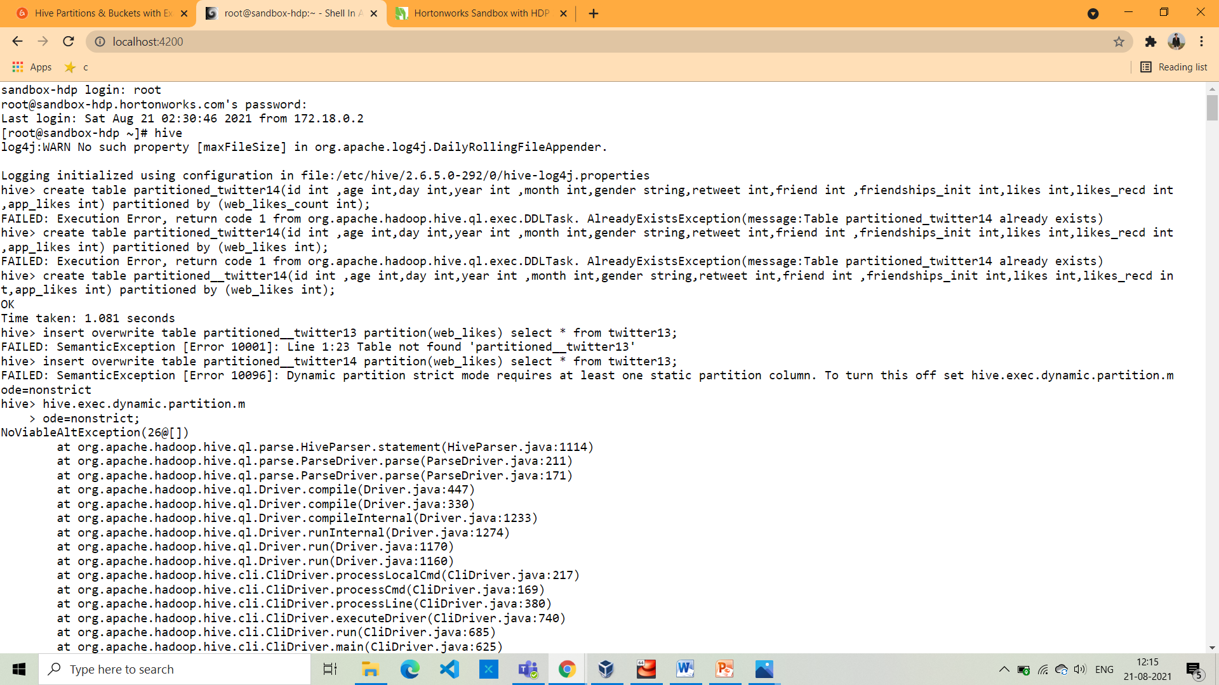
9.Create table using partition syntax: create table partitioned__twitter14(id int ,age int,day int,year int ,month int,gender string,retweet int,friend int ,friendships_init int,likes int,likes_recd in t,app_likes int) partitioned by (web_likes int);

Slide 14
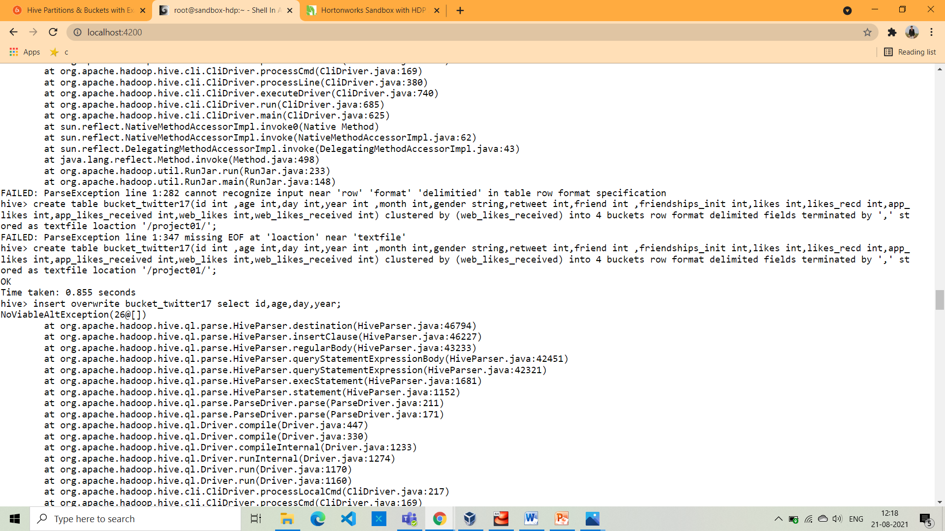
10.Create table using Bucket syntax: create table bucket_twitter17(id int ,age int,day int,year int ,month int,gender string,retweet int,friend int ,friendships_init int,likes int,likes_recd int,app_ likes int,app_likes_received int,web_likes int,web_likes_received int) clustered by (web_likes_received) into 4 buckets row format delimited fields terminated by ',' st ored as textfile location '/project01/';

Slide 15
THANK YOU.

